Slide 1
Linear Relationships – Gradient of Line and Y-intercept
Year 9 Maths

Slide 2
Contents
Formula Page
Page
Date
Description
2
3

Slide 3

Tasks
24
7
30
Essential Question
You should be ticking these off!
Complete the tasks on this side (left) of your page
Questions
Notes
Steps
Write your notes on this side (right) of your page
Your book, your responsibility!
Summary
Have YOU been doing your summaries?

Slide 4
24
7
30
Date: /9/2018
Linear Relationships
EQ – How do we use the gradient and y-intercept from a graph to form a linear equation?
25

Slide 5
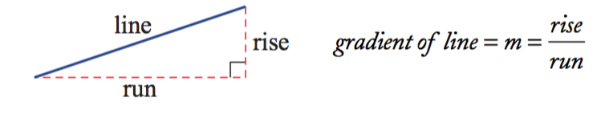
24
7
30
Date: /9/2018
Linear Relationships
EQ – How do we use the gradient and y-intercept from a graph to form a linear equation?
The gradient of a line is a measure of its slope.
What is gradient?
It is a number that shows the steepness of a line.
It is calculated by knowing how far a line rises or falls (called the rise) within a certain horizontal distance (called the run).
The gradient is equal to the rise divided by the run.
The letter m is used to represent gradient.
25

Slide 6
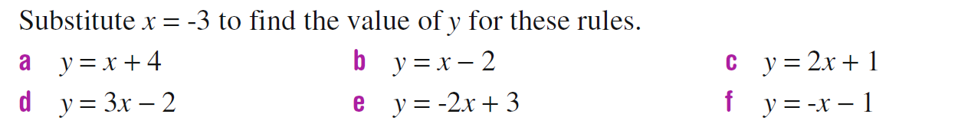
What’s the Value of Y?

Slide 7
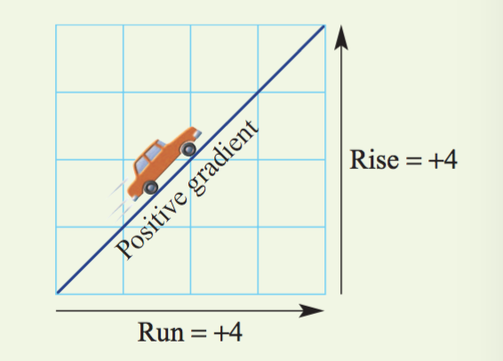
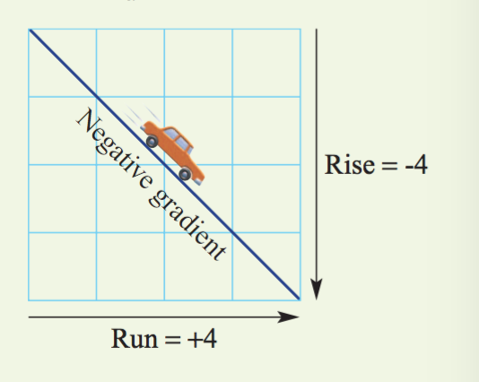
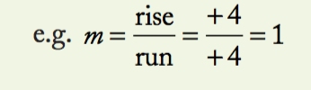
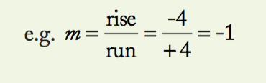
24
7
30
Date: /9/2018
Linear Relationships
EQ – How do we use the gradient and y-intercept from a graph to form a linear equation?
Important Note: Always move from left to right when considering the rise and the run.
If the line slopes up from left to right, the rise is positive and the gradient is positive.
If the line slopes down from left to right, the rise is considered to be negative and the gradient is negative.
25

Slide 8
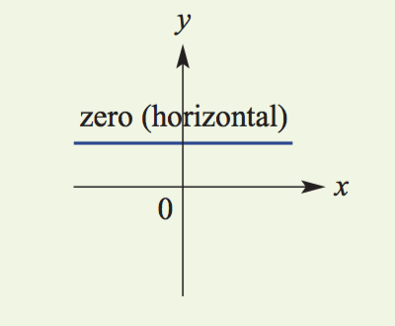
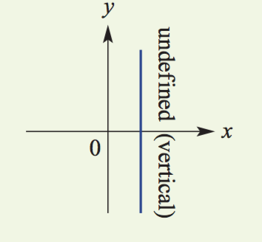
24
7
30
Date: /9/2018
Linear Relationships
EQ – How do we use the gradient and y-intercept from a graph to form a linear equation?
The gradient can also be zero (when a line is horizontal) and undefined (when a line is vertical).
25

Slide 9
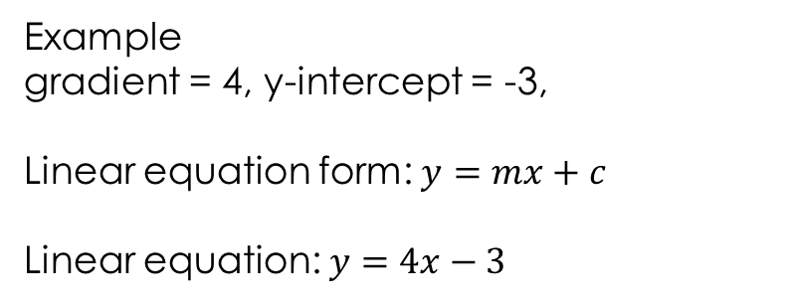
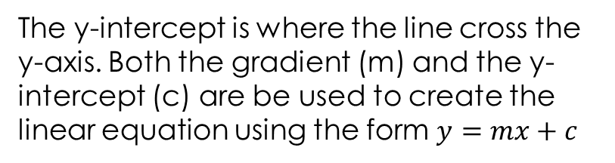
24
7
30
Date: /9/2018
Linear Relationships
EQ – How do we use the gradient and y-intercept from a graph to form a linear equation?
What is the y-intercept?
The y-intercept is where the line cross the y-axis. Both the gradient (m) and the y-intercept (c) are be used to create the linear equation using the form $y=mx+c$
Example
gradient = 4, y-intercept = -3,
Linear equation form: $y=mx+c$
Linear equation: $y=4x−3$
25

Slide 10
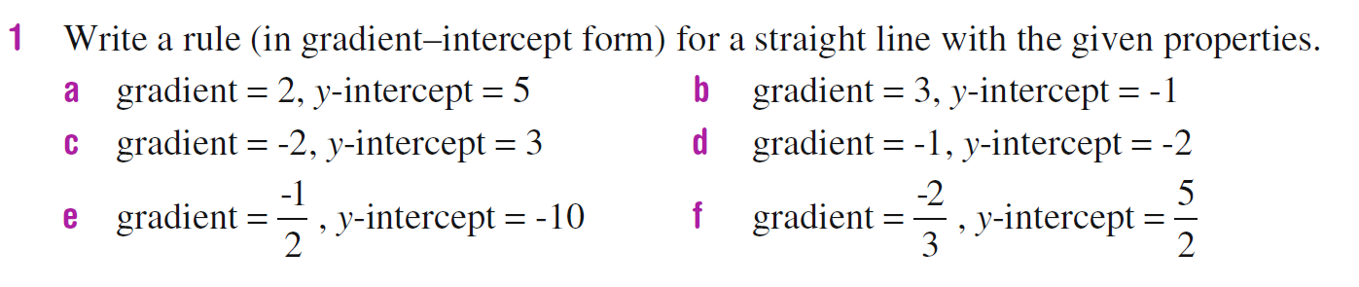
Task

Slide 11
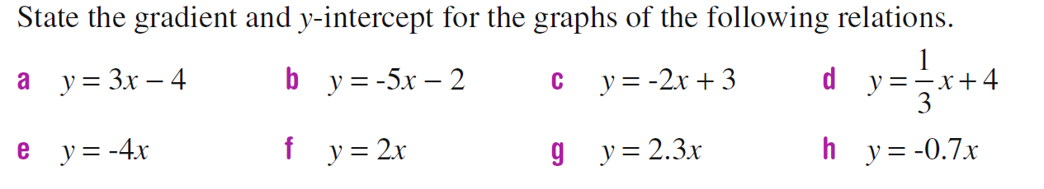
Task

Slide 12
REcap
Time to take look back at your work.
Write your summary.
Have you written the steps of determining a rule from a table of values in your own words?

Slide 13
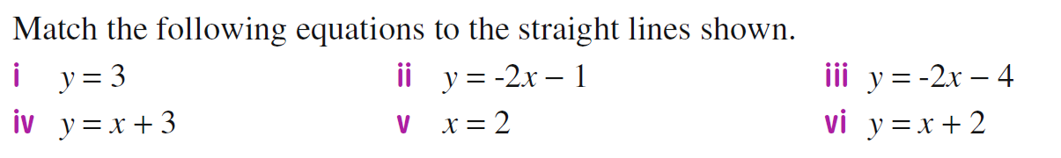
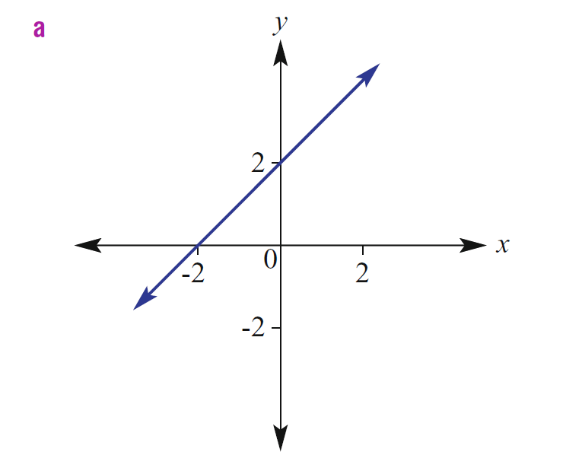
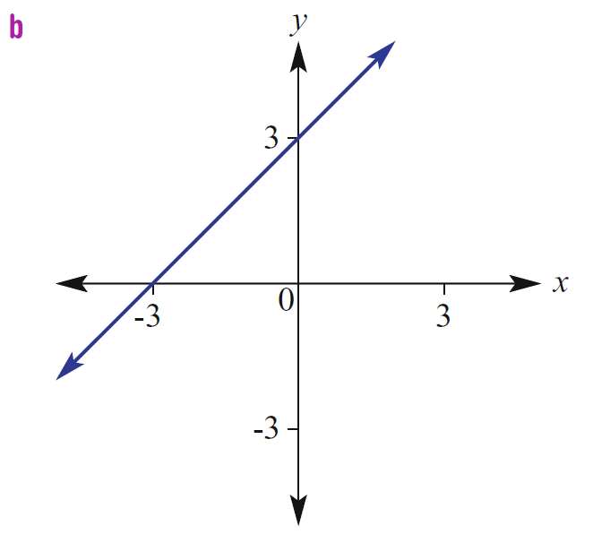
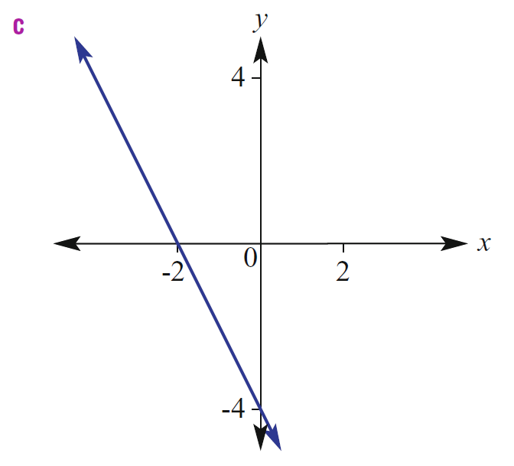
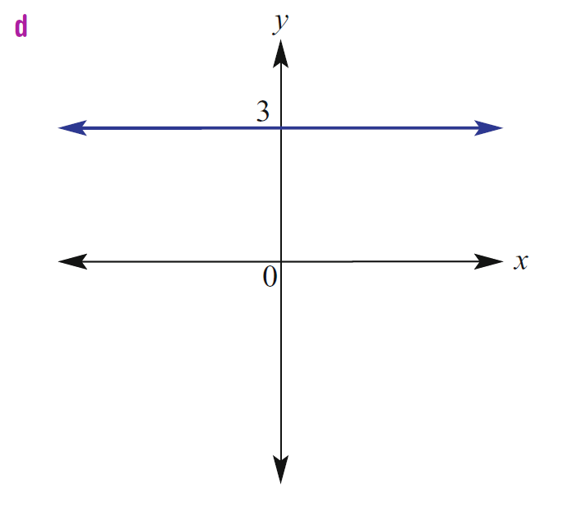
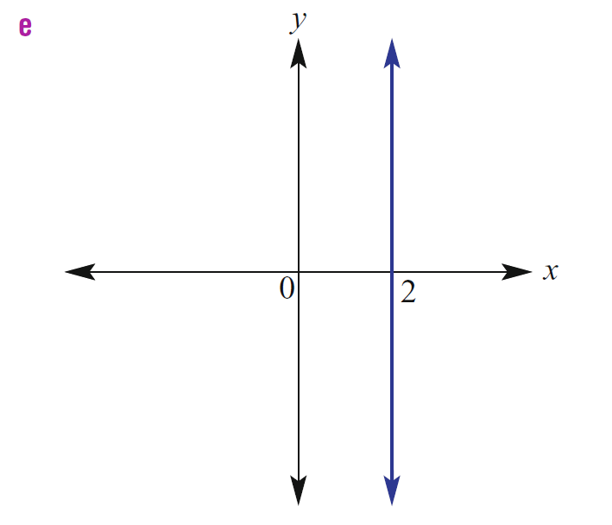
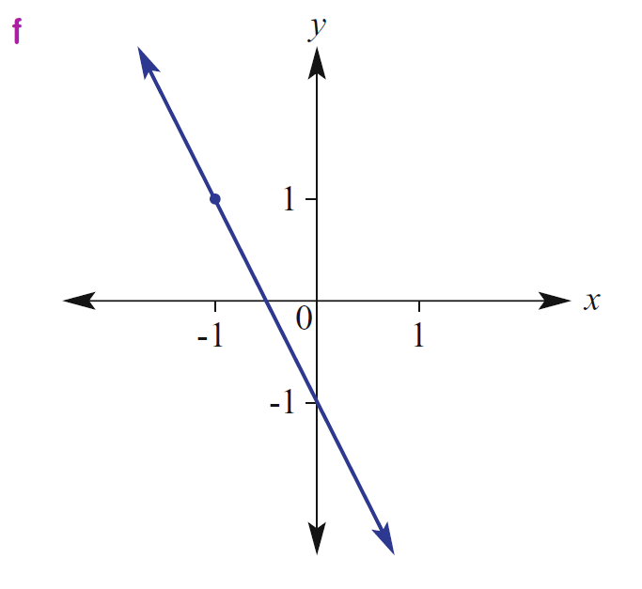

Slide 14






$$y=x+2$$
$$y=x+3$$
$$y=−2x−4$$
$$y=3$$
$$x=2$$
$$y=−2x−1$$

Slide 15
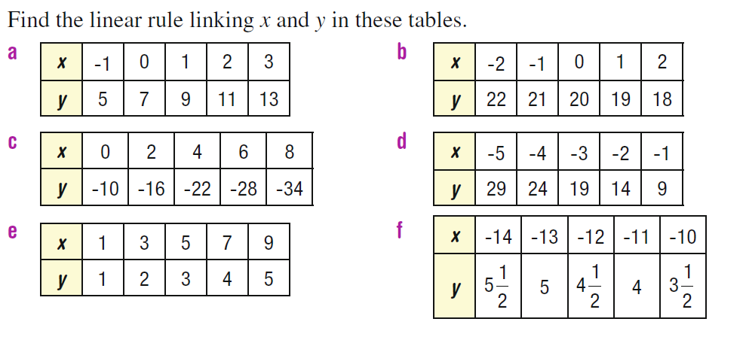
Challenge

